Slide 1

Explaining Neurodiversity with the Neurotrait Wheel
www.neurotrait.org

Slide 2


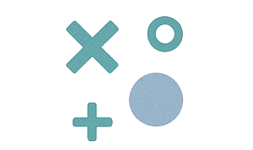
Neurodiversity: Natural variation in how brains work
Neurodiversity is how we describe the natural variations of how human brains work.
Neurodiverse conditions like autism, ADHD, dyslexia and others are not deficits or problems to be fixed. Just like biodiversity helps ecosystems thrive, neurodiversity brings strength to communities and teams through different perspectives and skills.
www.neurotrait.org

Slide 3


Which conditions are we talking about?
These are some common neurodivergent conditions.
Many people have more than one, or don’t fit neatly into one box, and everyone’s experience is different.
The point of the Neurotrait Wheel is to help us move beyond labels, to understand individual experiences by talking about traits.
ADHD
AUTISM
DYSLEXIA
DYSCALCULIA
TOURETTE’S
DYSPRAXIA
Other conditions can change how people process information, or respond to events around them and are sometimes classed as neurodivergence, like OCD and Parkinson’s. We’re focusing on the most common definition, which covers developmental and learning-based neurodivergence.
www.neurotrait.org

Slide 4
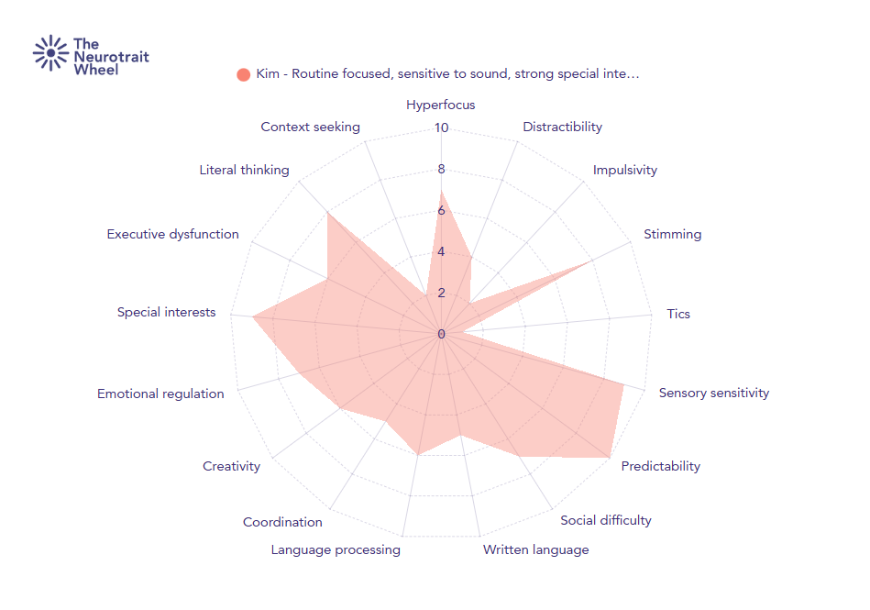
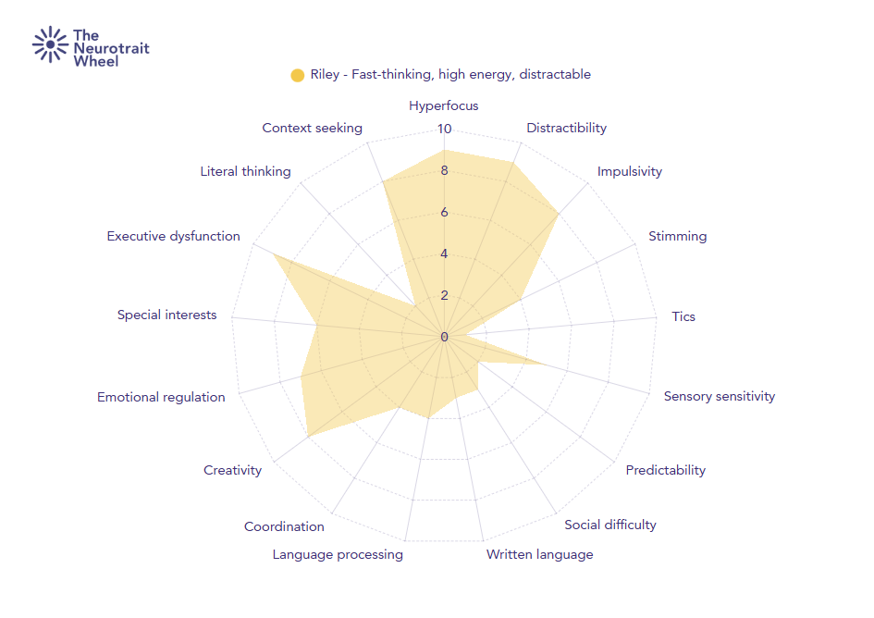
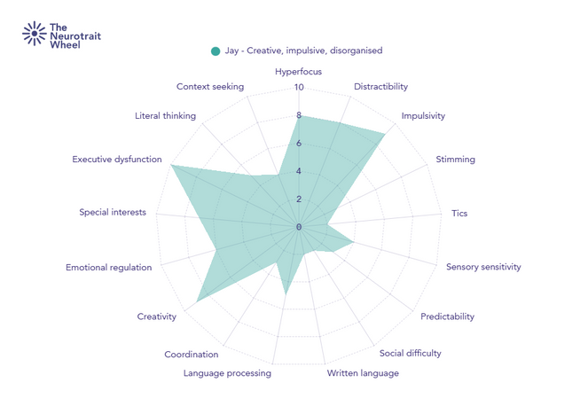
Introducing the Neurotrait Wheel
The neurotrait graph is a way for people to explain which traits impact them the most.
A person rates how much a trait affects them on an average day, from 0 (not at all) to 10 (a big part of life).
The resulting shape gives a visual sense of someone’s neurodivergent experience, not what a textbook says about their diagnosis.
www.neurotrait.org

Slide 5
About the Traits
These traits are some of the most common things that neurodivergent people experience. Some can be positive, some negative, and most depend on how much they show up in different circumstances.
There are lots of things that aren’t included on this list, but most neurodivergent people will experience many of these traits to some extent.
Hyperfocus
Distractibility
Impulsivity
Stimming
Tics
Sensory sensitivity
Need for predictability
Social difficulty
Written language difficulties
Language processing
Coordination
Creativity
Emotional regulation
Special interests
Executive dysfunction
Literal thinking
Context seeking

Slide 6
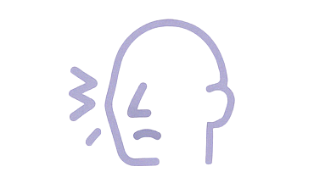
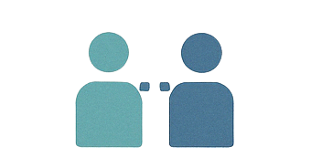
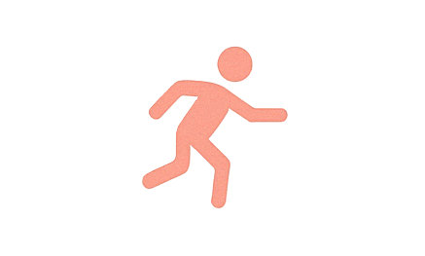

Why Traits?
We talk about traits, not just symptoms, or strengths.
“Traits” is a neutral word. It includes things that might be seen as symptoms, strengths, challenges, or quirks, and reflects how people actually experience these conditions.
Someone might find that their traits affect them more or less in different circumstances, in different jobs, and so on.
Everyone has traits - what matters is how much impact they have on someone’s everyday life.
www.neurotrait.org

Slide 7
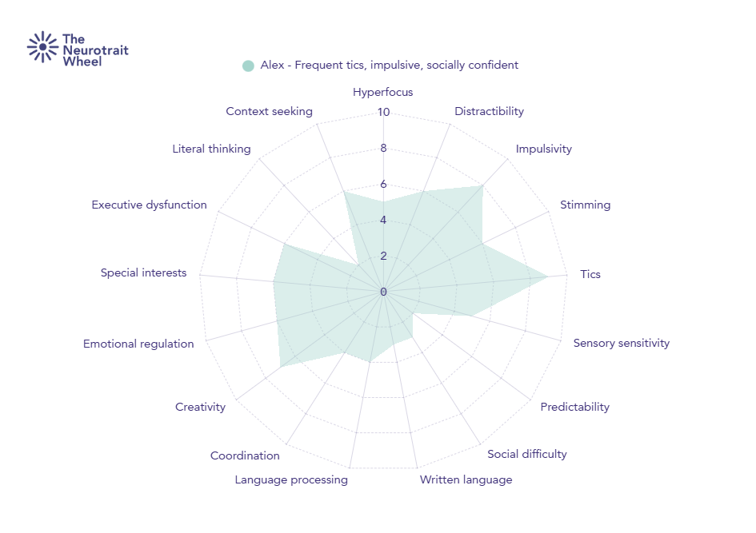
Neurodivergence in common
Alex has a diagnosis of Tourette’s syndome, and Riley has an ADHD diagnosis.
These are totally different labels, but the chart shows they have many traits in common.
Looking at traits rather than labels helps us see the things we all have in common.
www.neurotrait.org

Slide 8
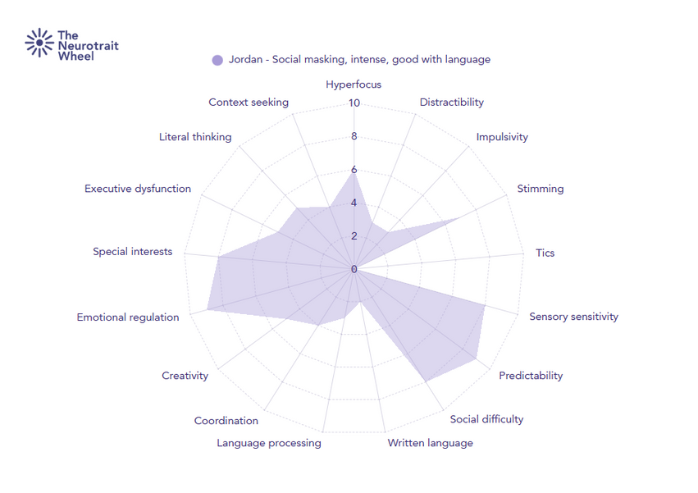
Same diagnosis, different experience
Kim and Jordan share an Autism diagnosis.
While they have a lot in common, they also show many differences.
Every person has unique experiences, which can be influenced by factors like their education, when (or if) they were diagnosed, their social class, ethnicity and gender, and so on.
www.neurotrait.org

Slide 9
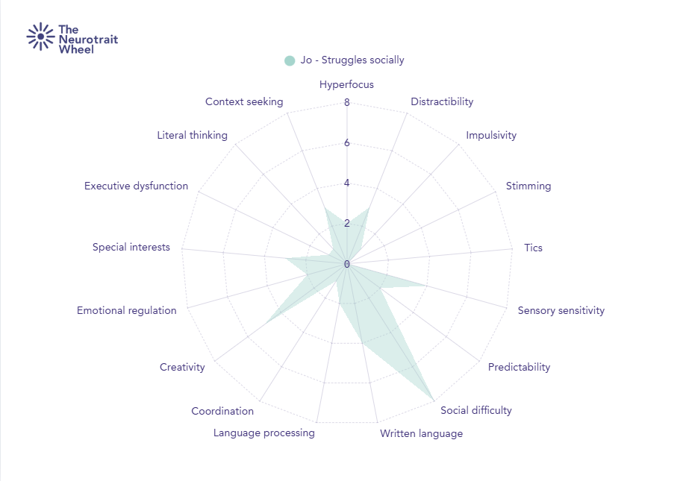
“Everyone is a bit Autistic”
It’s true that Neurodivergency exists on a spectrum, so everyone can experience some traits.
For example, Jo’s chart shows she struggles a lot socially, and can be sensitive to some sensory factors, like lots of noise.
BUT...
Jo doesn’t have the combination and intensity of traits that a Neurodivergent person would - most of the traits don’t impact her life much at all, so it’s not right to say she’s Neurodivergent.
www.neurotrait.org

Slide 10
Supporting Neurodivergent people at work
What you can do
  Look for people’s strengths, and make use of them
  Ask about needs, not labels
  Understand that traits may vary daily
  Don’t assume - listen to the individual
  Think flexibly - one size doesn’t fit all
  Use tools like this to guide conversations
Tools like the Neurotrait Wheel can help spark useful conversations, but they’re just the beginning.
The most important thing you can do is be open, listen without judgement, and focus on what helps each individual thrive.
Remember: not everyone gets a diagnosis, and not all people with the same diagnosis have the same needs. That’s why this trait-based model helps. It gives us a way to talk about what someone actually experiences day-to-day.
www.neurotrait.org

